Slide 1
The Abnormal, Adult, Middle Mediastinum
Samson Munn, M.D.
Tufts Medical Center

Slide 2
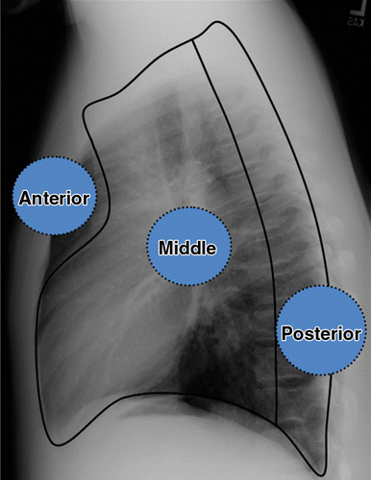
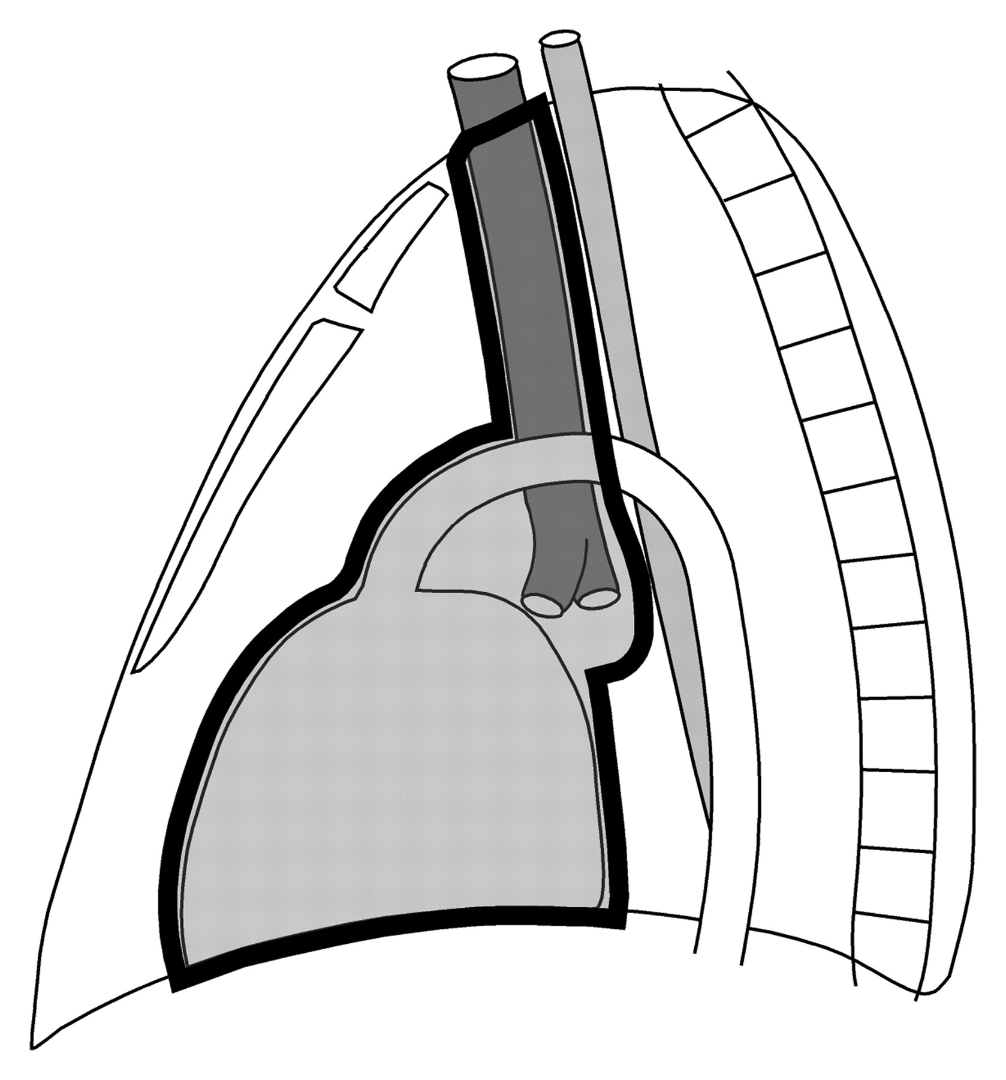
T E
Notes:
The anterior mediastinum is anterior to the anterior aspect of the pericardium. The posterior mediastinum is defined variably as posterior to the posterior aspect of the pericardium and trachea, or posterior to ~ 1 cm posterior to the anterior aspects of the vertebral column. The middle mediastinum is in between. If one invokes the existence of a “superior mediastinum,” then that is superior to a line drawn from the sternal angle (“angle of Louis”) to the superior aspect of the T-4 vertebral body.

Slide 3
What does the middle mediastinum contain?
Notes:
The middle mediastinum includes the heart, the great vessels, the central airways and the surrounding tissues, including fat, nerves and lymph nodes. It variably also includes esophagus.

Slide 4
What can go wrong in the middle mediastinum?
Notes:
The differential diagnostic gamut is dominated by the organs living in the middle mediastinum, commonly including:
esophageal pathology
fatty lesions
arterial problems
pulmonary arterial pathology
bronchial pathology
hernia(s)
lymphadenopathy
congenital anomalies.
Let’s look at some examples of the more common entities!

Slide 5
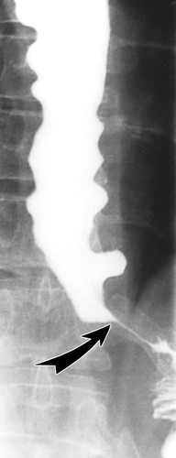
Same diagnosis, two patients.

Slide 6
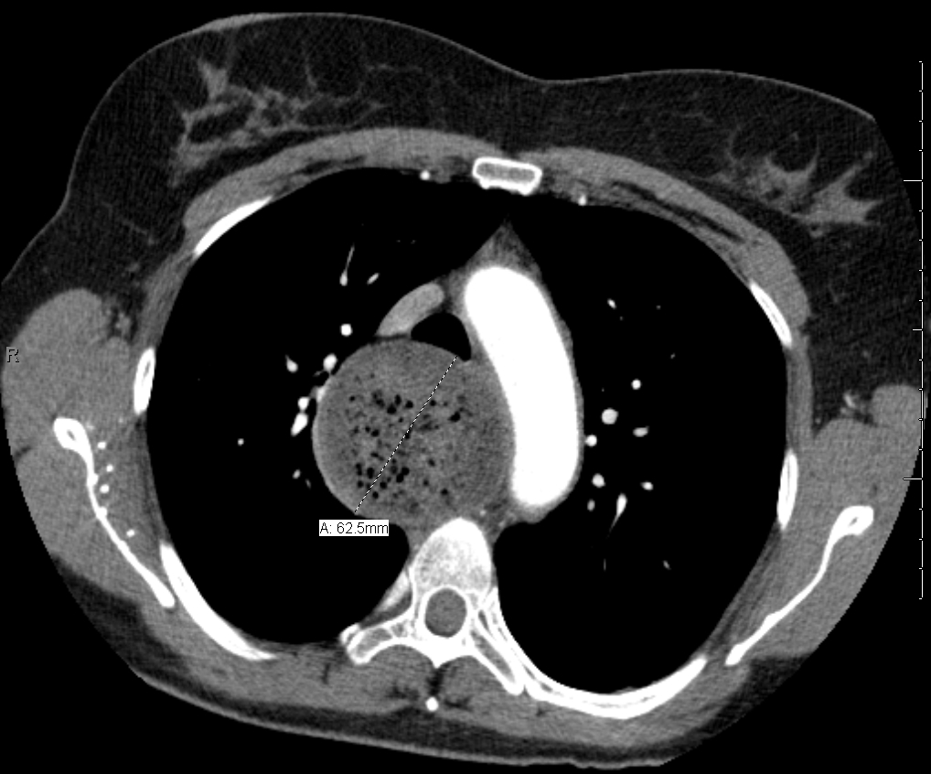
Esophageal Achalasia
Same diagnosis, three patients.
Notes:
Esophageal achalasia is a motility disorder involving the smooth muscle layer of the esophagus and the lower esophageal sphincter (LES). It is characterized by incomplete LES relaxation, increased LES tone, and lack of peristalsis of the esophagus (inability of smooth muscle to move food down the esophagus).
The main symptoms of achalasia are dysphagia (difficulty in swallowing), regurgitation of undigested food, chest pain behind the sternum, and weight loss. Dysphagia tends to become progressively worse over time and to involve both fluids and solids. Some people may also experience coughing when lying in a horizontal position. The chest pain experienced, also known as cardiospasm and non-cardiac chest pain can often be mistaken for a heart attack. It can be extremely painful in some sufferers. Food and liquid, including saliva, are retained in the esophagus and may cause aspiration.
Diagnosis is reached with esophageal manometry and barium swallow radiographic studies. Various treatments are available, although none cures the condition. Certain medications or Botox may be used in some cases, but more permanent relief is brought by esophageal dilatation and surgical cleaving of the muscle (so-called Heller myotomy).
The most common form is primary achalasia, which has no known underlying cause. It is due to failure of distal esophageal inhibitory neurons. However, a small proportion occurs secondary to other conditions, such as esophageal cancer or Chagas disease (an infectious disease common in South America). Achalasia affects about one person in 100,000 per year. There is no gender predominance for the occurrence of disease.
Note the characteristic megaesophagus and beak or bird’s beak appearance at the distal esophagus and gastroesophageal junction.

Slide 7
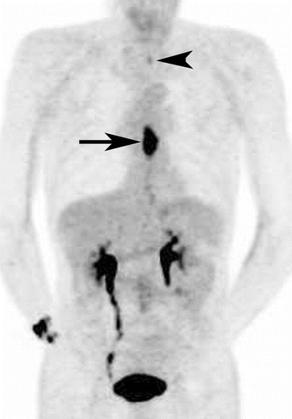
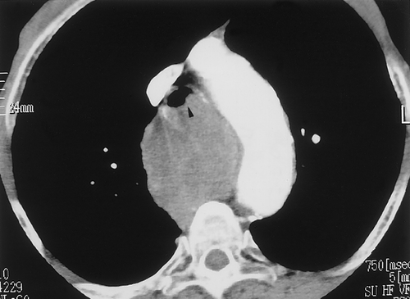
Same diagnosis, two patients.

Slide 8
Esophageal Carcinoma
Same diagnosis, two patients.
Notes:
The two main sub-types of esophageal carcinoma are squamous-cell carcinoma, which is more common in the developing world, and adenocarcinoma, which is more common in the developed world. Squamous-cell carcinoma arises from the epithelial cells that line the esophagus. Adenocarcinoma arises from glandular cells present in the lower third of the esophagus, often where they have already transformed to intestinal cell type (also known as Barrett's esophagus). The most common causes of the squamous-cell type are: tobacco, alcohol, very hot drinks, and a poor diet. The most common causes of the adenocarcinoma type are smoking, obesity, and acid reflux.
Note the large mass by CT, which is hot on PET imaging. A small upper mediastinal LN is also visualized.

Slide 9
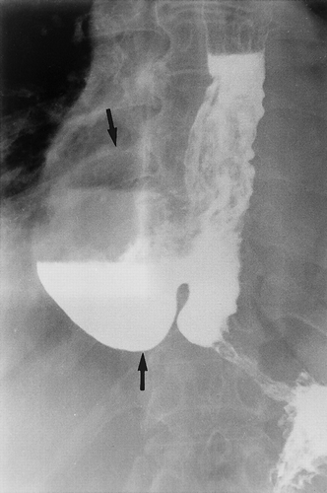
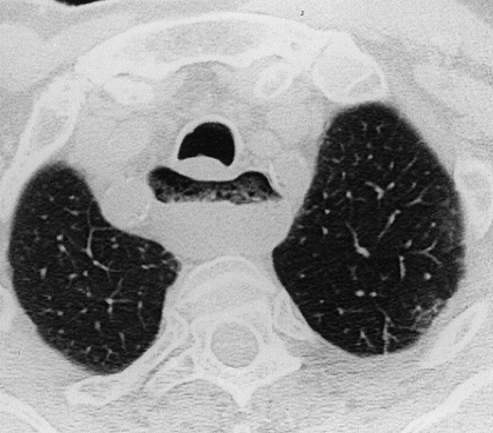
Similar – not idential -- diagnoses, two patients.

Slide 10
Esophageal Diverticulum
Huge Zenker’s diverticulum ↑
Similar – not idential -- diagnoses, two patients.
Notes:
An esophageal diverticulum is an outpouching of mucosa through the muscular layer of the esophagus. It can be asymptomatic or cause dysphagia and regurgitation.
There are several types of esophageal diverticula, each of different origin:
Zenker (pharyngeal) diverticula are posterior outpouchings of mucosa and submucosa through the cricopharyngeal muscle, probably resulting from an incoordination between pharyngeal propulsion and cricopharyngeal relaxation.
Midesophageal (traction) diverticula are caused by traction from cicatrix related to mediastinal inflammatory lesions, classically TB.
Epiphrenic (pulsion) diverticula occur just above the diaphragm and may accompany a motility disorder such as achalasia or diffuse esophageal spasm.
A Zenker diverticulum fills with food that might be regurgitated when the patient bends or lies down. Aspiration pneumonitis may result. Rarely, the pouch becomes large, causing dysphagia and sometimes a palpable neck mass.
Traction and lower esophageal pulsion diverticula are rarely symptomatic.

Slide 11
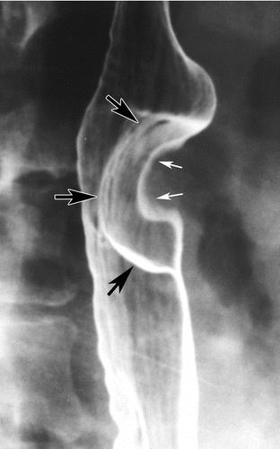

Slide 12
Esophageal Leiomyoma
Notes:
Oesophageal leiomyoma is a benign smooth-muscle neoplasm of the oesophagus. It is the most common benign tumour of the oesophagus.
It most frequently presents in young and middle age groups (20-50 years). The overall incidence is around 25 per 10,000 by autopsy series.
The clinical presentation would often depend on the size of tumour:
small tumours (<5 cm): usually no symptoms
large tumours: may cause dysphagia, regurgitation, oesophageal obstruction,chest pain, cough, and rarely bleeding
Like other leiomyomas, they comprise smooth muscle overgrowth.
They typically involve the mid-to-distal esophagus.
On barium swallow, one sees a discrete ovoid mass that is well outlined by barium. Its borders classically form 90-degree or slightly obtuse angles with the esophageal wall.
CT findings include:
ovoid intramural solitary mass with a smooth surface
the presence of calcifications is almost pathognomonic
narrowing of esophageal lumen
displacement of the esophageal lumen
moderate diffuse contrast-enchancement
absence of signs of invasion of adjacent tissue

Slide 13
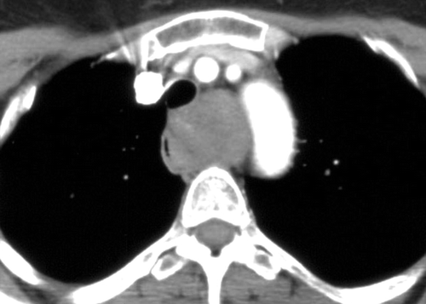
Other Esophageal Benign Lesions

Slide 14
Other Esophageal Benign Lesions
(schwannoma)
Notes:
Esophageal Schwannomas are rare. Under 100 cases have ever been reported. Most occur in middle age, with women more common than men, and Asians more common than other ethnicities. The youngest case ever reported was a 22 year old Asian-American male.
Schwannomas are benign tumors of peripheral nerve sheaths.

Slide 15
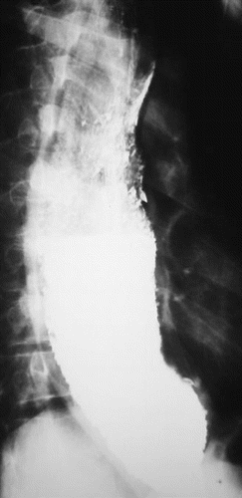

Slide 16
Flashback: Megaesophagus
Chagas Disease
Notes:
Chagas disease is caused by the parasite Trypanosoma cruzi, which is transmitted to animals and people by insect vectors that are found only in the Americas (mainly, in rural areas of Latin America where poverty is widespread). Chagas disease is also referred to as American trypanosomiasis.
It is estimated that as many as 8 million people in Mexico, Central America, and South America have Chagas disease, most of whom do not know they are infected. If untreated, infection is lifelong and can be life threatening.
The impact of Chagas disease is not limited to the rural areas in Latin America in which vectorborne transmission occurs. Large-scale population movements from rural to urban areas of Latin America and to other regions of the world have increased the geographic distribution and changed the epidemiology of Chagas disease. It is now found in the United States and in other regions where Chagas disease, but is not endemic there.
In Chagas disease-endemic areas, the main mode of transmission is vector-borne. The insect vectors are called triatomine bugs, which are blood-sucking like mosquitos. Once infected, the bugs pass T. cruzi parasites in their feces. The bugs are found in houses made from materials such as mud, adobe, straw, and palm thatch. During the day, the bugs hide in crevices in the walls and roofs. During the night, when the inhabitants are sleeping, the bugs emerge. Because they tend to feed on people's faces, triatomine bugs are also known as "kissing bugs. " After they bite and ingest blood, they defecate on the person. The person can become infected if T. cruzi parasites in the bug feces enter the body through mucous membranes or breaks in the skin. The unsuspecting, sleeping person may accidentally scratch or rub the feces into the bite wound, eyes, or mouth.
People also can become infected through:
congenital transmission (from a pregnant woman to her baby);
blood transfusion;
organ transplantation;
consumption of uncooked food contaminated with feces from infected bugs; and
accidental laboratory exposure.
Much of the clinical information about Chagas disease comes from experience with people who became infected as children through vectorborne transmission. The severity and course of infection might be different in people infected at other times of life, in other ways, or with different strains of the T. cruzi parasite.
There are two phases of Chagas disease: the acute phase and the chronic phase. Both phases can be symptom free or life threatening.
The acute phase lasts for the first few weeks or months of infection. It usually occurs unnoticed because it is symptom-free or exhibits only mild symptoms and signs that are not unique to Chagas disease. The symptoms noted by the patient can include fever, fatigue, body aches, headache, rash, loss of appetite, diarrhea, and vomiting.
During the chronic phase, the infection may remain silent for decades or even for life. However, some people develop:
cardiac complications, which can include an enlarged heart (cardiomyopathy), heart failure, altered heart rate or rhythm, and cardiac arrest (sudden death); and/or
intestinal complications, which can include an enlarged esophagus (megaesophagus) or colon (megacolon) and can lead to difficulties with eating or with passing stool.
The average life-time risk of developing one or more of these complications is about 30%.

Slide 17
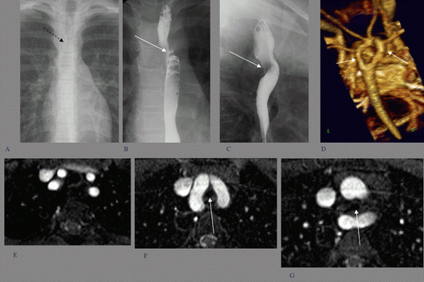

Slide 18
Vascular Ring
Example: Double Aortic Arch with
Impression on Trachea and Esophagus
Notes:
Double aortic arch is a congenital anomaly of the aortic arch system in which the trachea and esophagus are completely encircled by connected segments of the aortic arch and its branches. Although the double aortic arch has various forms, the common defining feature is that both the left and right aortic arches are present.
The easiest way to understand the anatomy and development of double aortic arch and other forms of vascular ring is to begin by considering the bilateral system of pharyngeal arch vessels in the early embryo.
Early in the course of embryonic morphogenesis, 6 pairs of pharyngeal arch arteries develop in conjunction with the branchial pouches. The first through sixth arches appear in a fairly sequential fashion, with left-to-right symmetry, and constitute the primitive vascular supply to the brachiocephalic structures. As normal cardiovascular morphogenesis proceeds, a patterned regression and persistence of the various arches and right-sided dorsal aorta occur, ultimately resulting in the mature configuration of the thoracic aorta and its branches. The third, fourth, and sixth arches, along with the seventh intersegmental arteries and the left dorsal aorta, are the primary contributors to the normal aortic arch and its major thoracic branches.
The segments of the bilateral aortic arch system that normally regress include the distal portion of the sixth arch and the right-sided dorsal aorta. Normally, the left fourth arch becomes the aortic arch. Vascular rings are formed when this process of regression and persistence does not occur normally, and the resulting vascular anatomy completely encircles the trachea and esophagus. A double aortic arch is formed when both fourth arches and both dorsal aortas remain present.

Slide 19
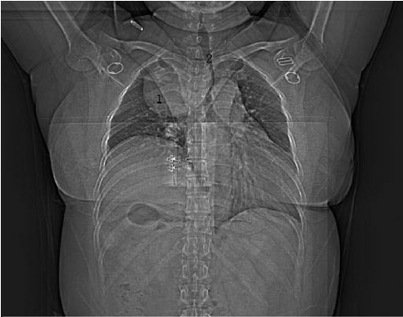
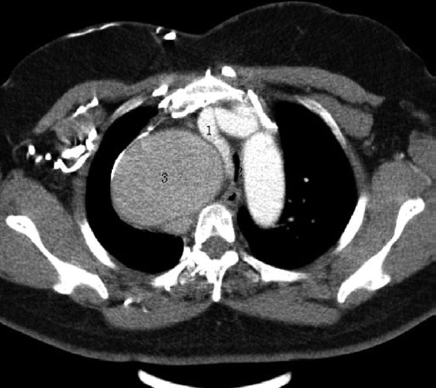
Same patient, same time.

Slide 20
Aortic or Brachiocephalic Artery Aneurysm
Example: Right Subclavian Artery Aneurysm
Same patient, same time.
Notes:
Aneurysms of supraaortic trunks and of internal carotid arteries are very rare; their incidence ranges between 0.4 and 4% of all types of aneurysms. The most common site is carotid artery bifurcation followed by internal and common carotid artery. Isolated aneurysms of subclavian and innominate artery are the most rare: only 3 cases have been described out of 1147 aneurysms or 0.003% in a case series. Innominate artery aneurysms have been divided into 3 categories: type A, with no involvement of the origin of the IA (rare); type B, with involvement of the origin of the IA but not of the aorta (the most common); type C, with involvement of both the IA and the aorta.
The etiology is multifactorial and has changed over the past decades: in the 1950s most innominate artery aneurysms were syphilitic -- massive lesions, difficult to treat and with a poor prognosis. With modern imaging technologies, the diagnosis of small asymptomatic aneurysms has become increasingly common, especially during the workup for thoracic and abdominal aneurysm. Nowadays atherosclerosis accounts for more than 60% of cases. Infectious etiologies, such as syphilis, mycotic aneurysm, tuberculosis, are decreasing, while autoimmune diseases (e.g., Beçhet Syndrome, Takayasu arteritis), connective tissue disorders, such as Marfan’s syndrome and Ehlers-Danlos syndromes, and post-traumatic forms, are increasing in relative frequencies.

Slide 21
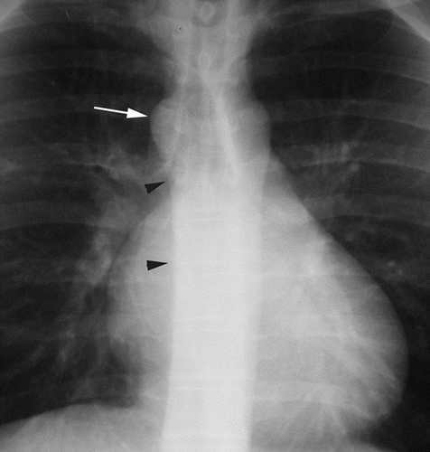
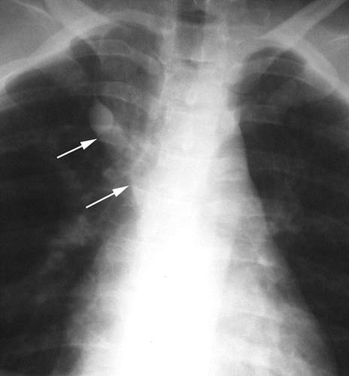
Similar diagnosis, two patients.

Slide 22
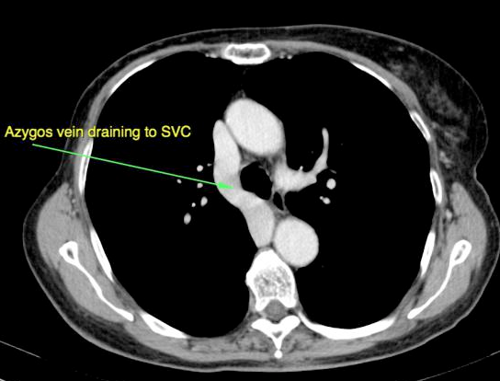
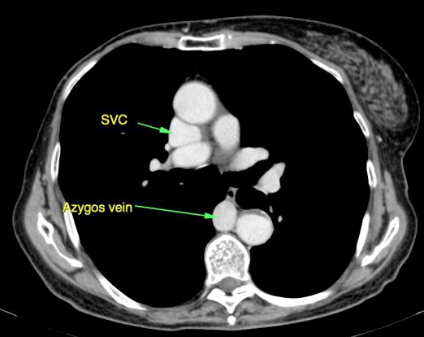
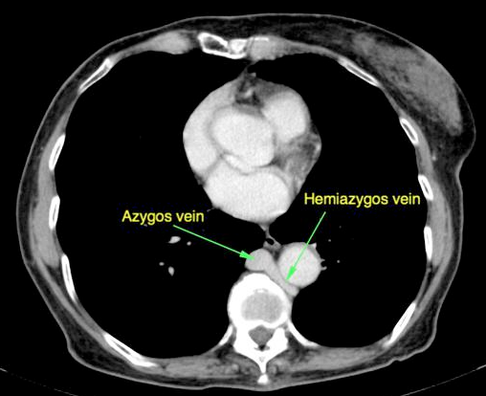
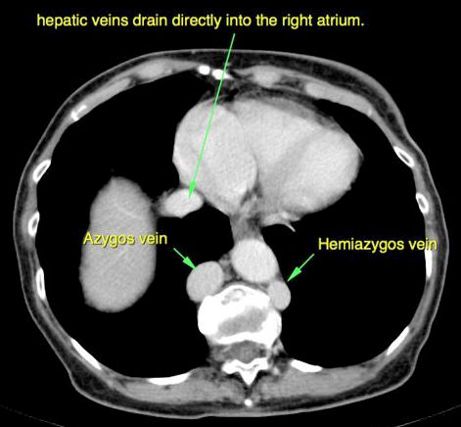
Azygos Continuation of the IVC
Dilated Azygos Vein
Double IVC with Azygos and Hemiazygos Continuation of the IVC
(without azygos lobe)
(with azygos lobe)
Notes:
Azygos continuation of the IVC has a prevalence of ~1.5% (range 0.2-3%). It is seen in the above two radiographs, but these could represent dilated azygos veins of other etiology. An association with congenital heart disease and asplenia or polysplenia syndromes has been reported. In most cases, it is found incidentally in asymptomatic patients.
It is important to recognize the enlarged azygos vein at the confluence with the superior vena cava and in the retrocrural space to avoid misdiagnosis as right-sided paratracheal mass or retrocrural adenopathy.
As the name suggests, the hepatic segment of the inferior vena cave is absent and the hepatic veins join and drain directly into the right atrium.
A commonly associated abnormality is duplication of inferior vena cava. In these cases, usually, the left IVC typically ends at the left renal vein which crosses anterior to the aorta to join the right IVC. Then the right IVC remains as the azygos vein, not coursing through the liver. The azygos vein joins the superior vena cava (SVC) at the normal location in the right paratracheal space.
Other arrangements in duplicated inferior vena cava drainage can be found, such as:
double IVC with retroaortic right renal rein and hemiazygos continuation of the IVC; and,
double IVC with azygos and hemiazygos continuation of each duplicated IVC, which you see above, by CT.
In the frontal chest x-ray, the mediastinum is widened and the azygos arch enlarged, as in the above two radiographic examples.
Cross-sectional imaging usually has no difficulty in identifying the abnormality, demonstrating the anatomy elegantly.

Slide 23
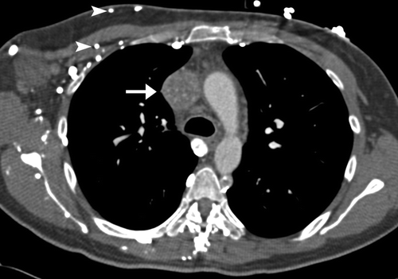
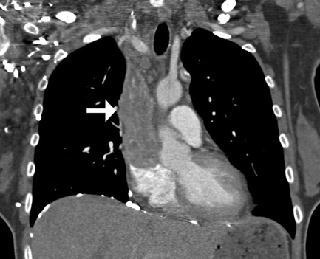
Two images of a patient, same time.

Slide 24
Dilated Superior Vena Cava
Heterogeneous Internal Enhancement c/w Tumor Thrombus
Same patient, same time.
Notes:
Obstruction of the superior vena cava (SVC) may be caused by neoplastic invasion of the venous wall associated with intravascular thrombosis or, more simply, by extrinsic pressure of a tumor mass against the relatively fixed thin-walled superior vena cava (SVC). Other causes include compression by intravascular arterial devices. The incidence is on the rise in line with the increased usage of endovascular devices. An obstructed superior vena cava (SVC) initiates collateral venous return to the heart from the upper half of the body through 4 principal pathways. The first and most important pathway is the azygos venous system, which includes the azygos vein, the hemiazygos vein, and the connecting intercostal veins, which can be seen on the patient’s right side, above. The second pathway is the internal mammary venous system, seen in the image on your left, above, plus tributaries and secondary communications to the superior and inferior epigastric veins. The long thoracic venous system, with its connections to the femoral veins and vertebral veins, provides the third and fourth collateral routes, respectively. Despite these collateral pathways, venous pressure is almost always elevated in the upper compartment if obstruction of the superior vena cava (SVC) is present. Venous pressure as high as 200-500 cm H₂O has been recorded in patients with severe superior vena cava syndrome. Frequency Superior vena cava syndrome develops in 5-10% of patients with a right-sided malignant intrathoracic mass lesion.

Slide 25
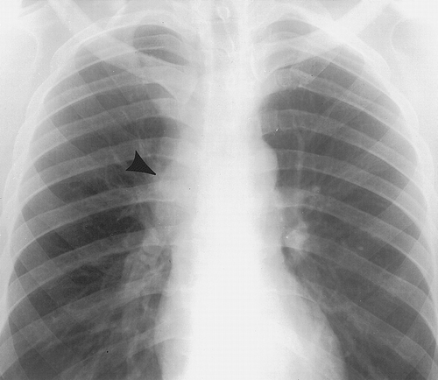
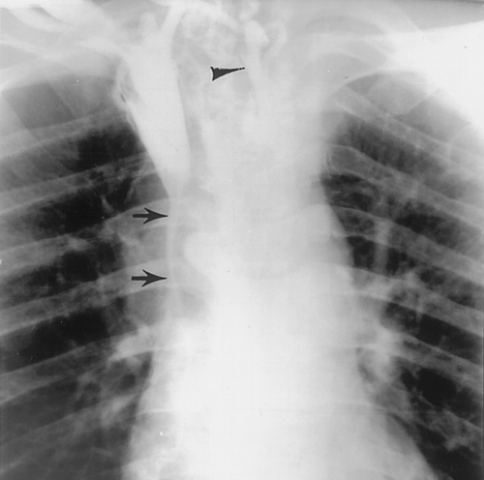
Same patient, same time.

Slide 26
Fibrosing Mediastinitis
(histoplasmosis)
Same patient, same time.
Notes:
Fibrosing mediastinitis is a rare non malignant acellular collagen and fibrous tissue proliferative condition occurring within the mediastinum. On imaging, the condition can sometimes mimic malignancy.
Although it can potentially present at any age, it typically presents in young adults.
Affected patients usually present with signs and symptoms of obstruction or compression of the superior vena cava, pulmonary veins or arteries, central airways and/or esophagus.
It is characterized by chronic inflammation and excessive fibrosis of mediastinal soft tissues. This may lead to compression and sometimes occlusion of mediastinal structures.
There are two main types:
focal: ~80%
diffuse: ~20%.
idiopathic: most cases
Histoplasmosis): common in the United States and often causes the focal pattern
Tuberculosis
concurrent intra-thoracic malignancy
Sarcoidosis
radiation therapy
drugs, e.g. methylsergide therapy
Rarely associated with:
Reidel thyroiditis
retroperitoneal fibrosis
Behcet disease
rheumatoid arthritis (RA)
systemic lupus erythematosus (SLE)
Chest X-rays can be subtle with non-specific widening of the mediastinum. There can be distortion and obliteration of normally recognizable mediastinal interfaces or lines. An accompanying feature may be calcification of the mediasinum or hila.

Slide 27
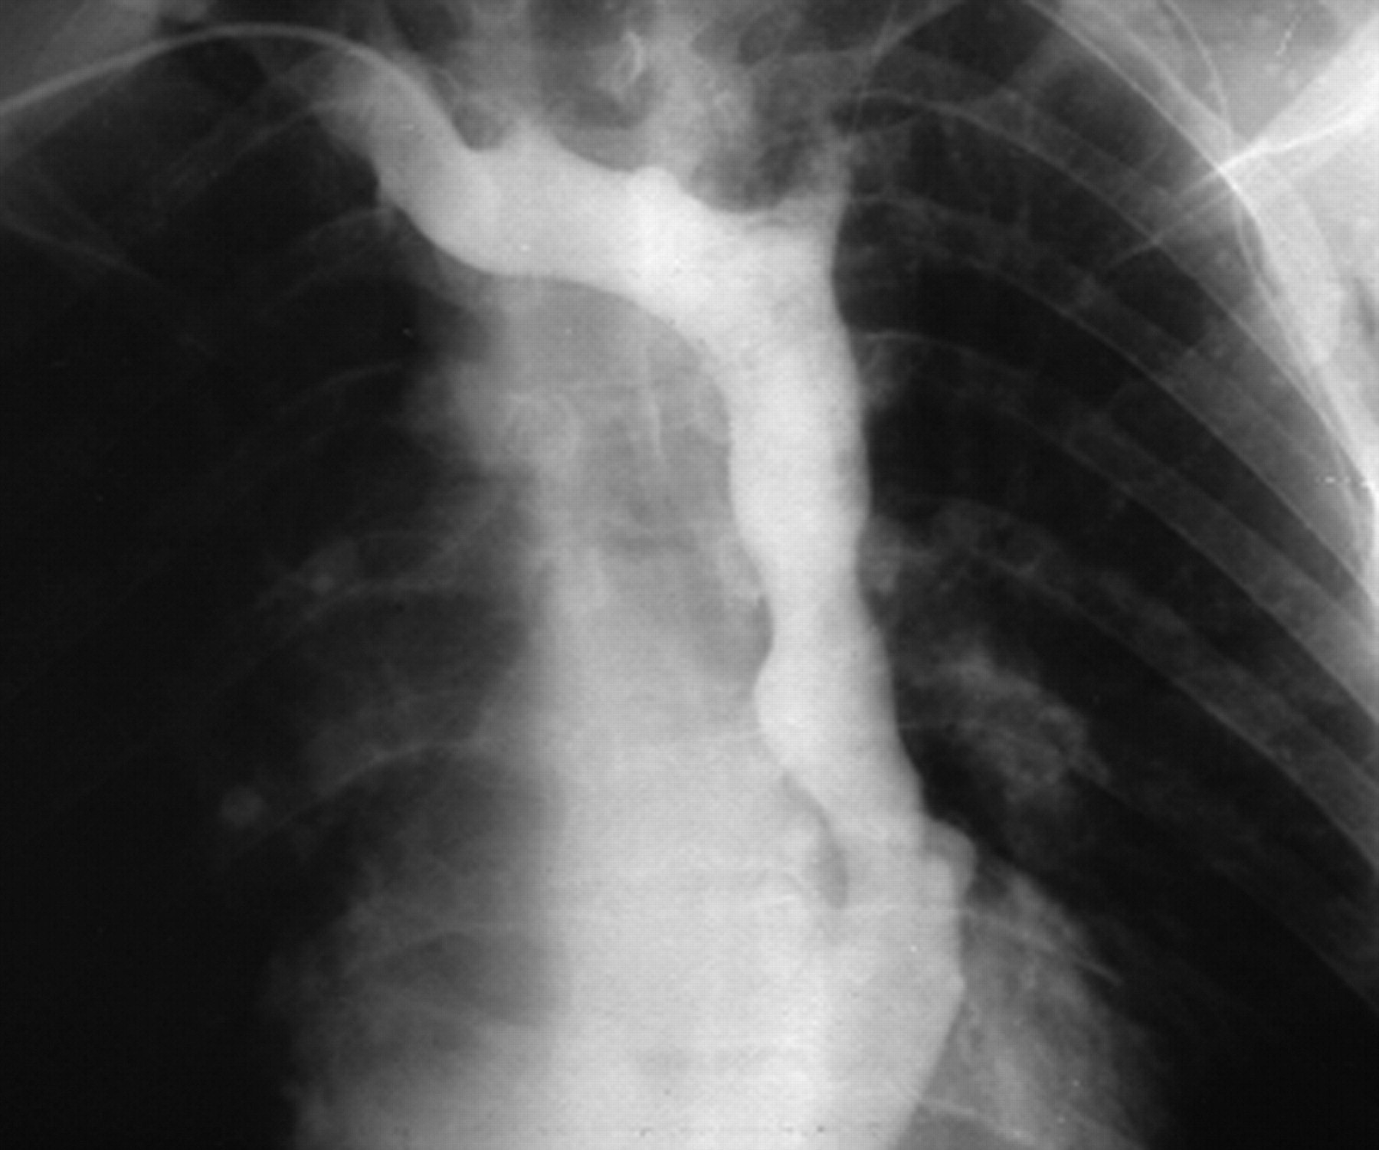

Slide 28
Left-Sided Superior Vena Cava
Notes:
A left sided superior vena cava (SVC) is the most common congenital venous anomaly in the chest. It can rarely result in a right-to-left shunt.
A left sided SVC is seen in 0.4% of the normal population and in ~5% of those with congenital heart disease. It is only seen in isolation in 10% of cases since the vast majority are accompanied by a normal right sided SVC, called SVC duplication.
The vast majority of cases are asymptomatic and the presence of the vessel is only identified incidentally during CT scanning of the chest, or as a result of line placement. In those patients who have a right to left shunt as a result of drainage directly into the left atrium, the shunt is usually not large enough to cause cyanosis since it only drains the left upper limb and left side of the head and neck.
A left sided SVC forms when the left anterior cardinal vein is not obliterated during normal fetal development. The persistent left-sided SVC passes anterior to the left hilum and lateral to the aortic arch before rejoining the circulatory system. About 92% drain into the coronary sinus, functionally insignificant since venous return from the head, neck and upper limbs is delivered to the right atrium; about 8% drain into the left atrium, resulting in a right to left shunt which is usually not large enough to cause cyanosis or symptoms.
In the vast majority of cases (82-90%) a normal (but small) right sided SVC is also present, and a persistent bridging vein (left brachiocephalic vein) is sometimes also present.
Other configurations are also possible, one of which is the left superior intercostal vein forming a communication between the left SVC and the accessory hemiazygous vein forming a left sided azygous arch.
Plain film
Direct visualisation of a left sided SVC is not possible however its presence can be implied if a catheter or line is in an unexpected left paramediastinal location.
CT
CT, especially with contrast, is able to elegantly demonstrate the anomalous vessel coursing inferiorly to the left of the arch of the aorta and anterior to the left hilum. It is in direct continuation of the confluence of the left jugular vein and the left subclavian vein. A communication between the normal right SVC (which is present in 82-90% of cases) may also be seen.
Depending on the timing of the scan and the side of the injection variable amounts of contrast may be seen within the vessel.
CT is also able, especially with the benefit of reformats, to delineate the site of drainage (usually coronary sinus).

Slide 29
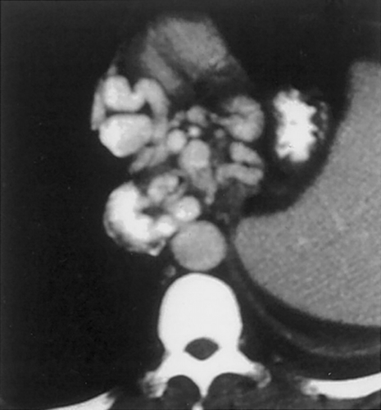

Slide 30
Varices

Slide 31
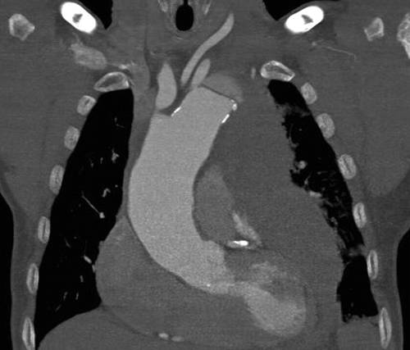

Slide 32
Aortic Dissection and Hemorrhage
(Stanford type B)

Slide 33
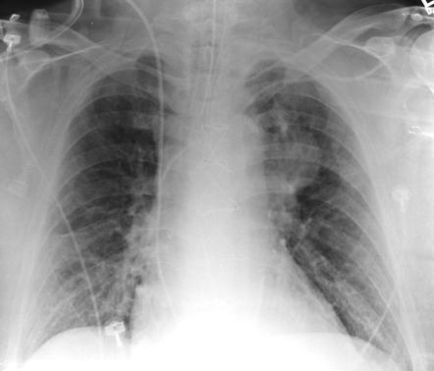

Slide 34
Thoracic Aortic Aneurysm

Slide 35
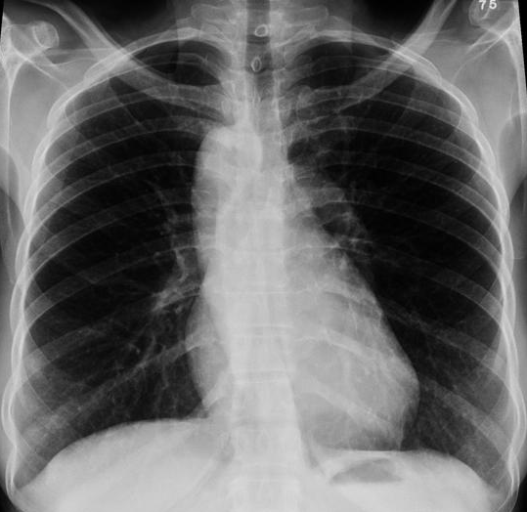

Slide 36
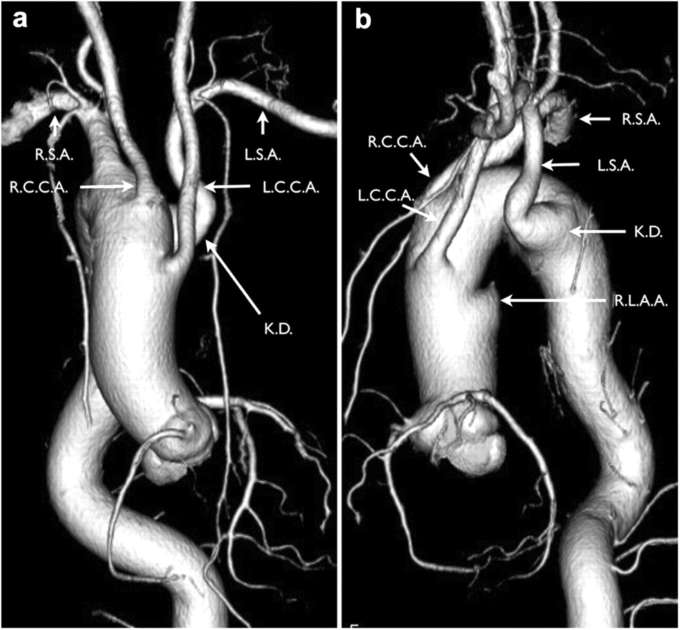
Right Aortic Arch
with Right Descending Thoracic Aorta
Notes:
Right aortic arch is thought to occur in approximately ~ 0.1% of the population, or 1 of 1,000 people.
Right arch can be divided into at least three types:
Probably around 60% or more: right sided aortic arch with aberrant left subclavian artery, usual asymptomatic but rarely causes esophageal or tracheal compression; KD in the image on your right refers to a diverticulum of Kommerell;
Probably around 40% or less: right sided aortic arch with mirror image branching, associated with cyanotic heart disease.
Less than 1%: Right sided aortic arch with isolation of the left subclavian artery – that means the remaining left arch is interrupted at two levels, one on each side of the level of the origin of the left subclavian artery.
By chest radiograph,
the usual left aortic knob contour is absent
there are tracheal bowing to the left at the the level of the right aortic arch, and soft tissue indentation on right side of the distal trachea
there is a right sided descending aorta
The right arch is often seen as high riding, too, but this not the case in this example.

Slide 37
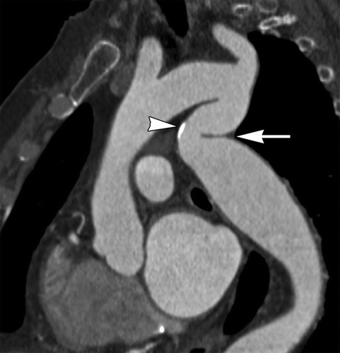

Slide 38
Pseudocoarctation of the Aorta
Notes:
Pseudocoarctation of the aorta is a very rare anomaly characterized by kinking or buckling of the descending aorta at the level of the ligamentum arteriosum without a pressure gradient across the lesion.

Slide 39
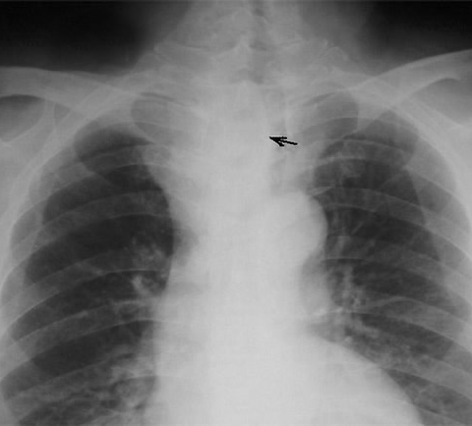
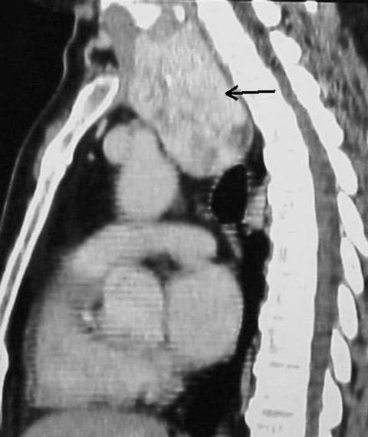
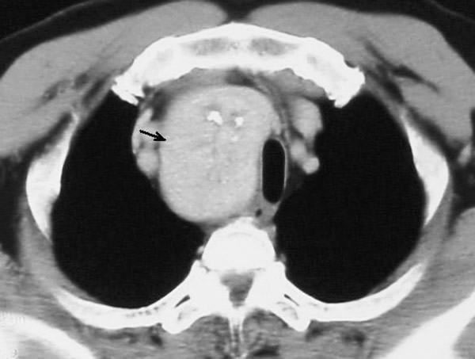
Same patient, same time.

Slide 40
Thyroid
Goiter
Same patient, same time.

Slide 42
Thyroid Cancer
Notes:
Thyroid cancer presenting as a mediastinal mass is almost always via direct extension; this rare case is an example of carcinoma in ectopic thyroid tissue – the normally positioned gland was normal !

Slide 43
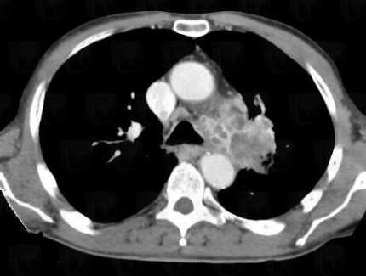

Slide 44
Bronchogenic Carcinoma with Direct Extension into Middle Mediastinum

Slide 45
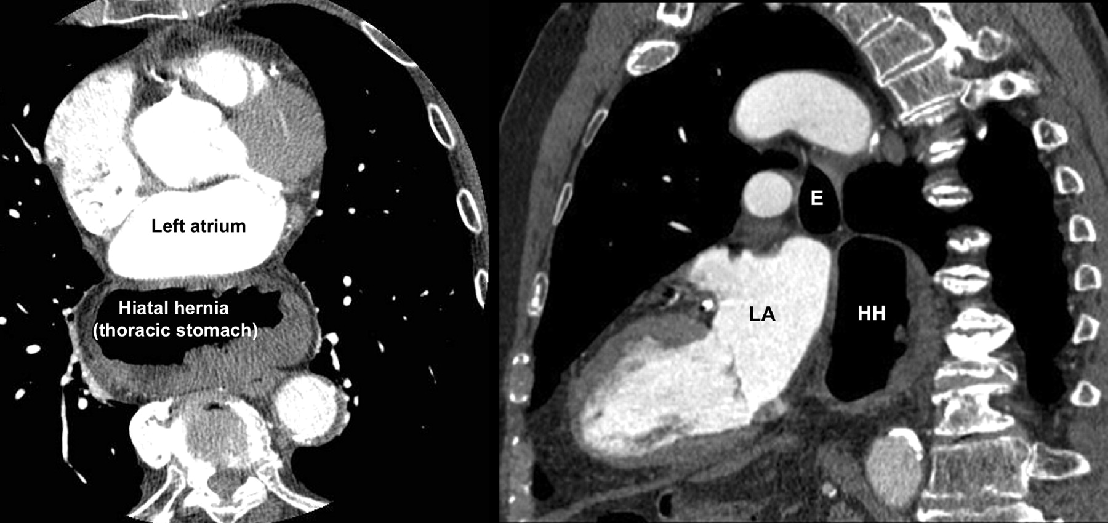
Hiatus Hernia Presenting in the Middle Mediastinum

Slide 46
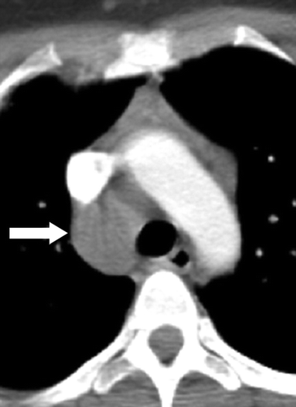
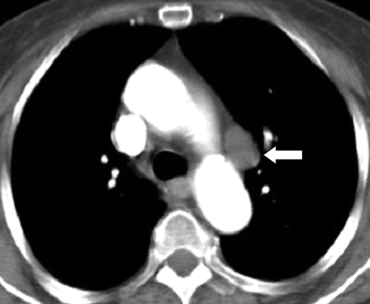
Similar diagnosis, two patients.

Slide 47
Lymphadenopathy
(metastases)
Similar diagnosis, two patients.

Slide 49
Lymphoma

Slide 50
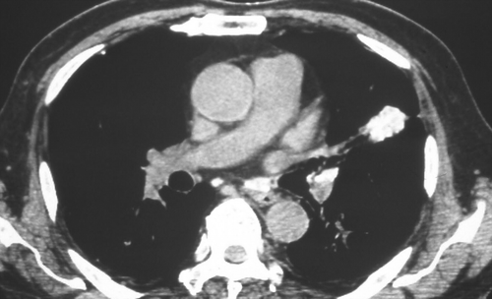
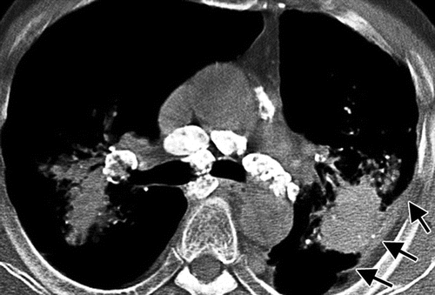
Pneumoconioses
Talcosis Silicosis

Slide 51
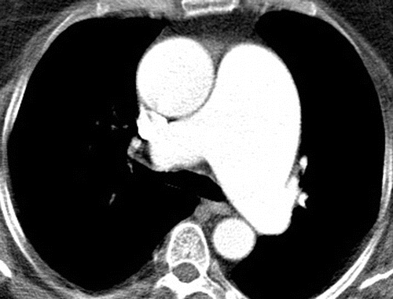
Dilated Pulmonary Artery
Ddx.: PA hypertension, idiopathic, post-stenotic, etc.

Slide 52
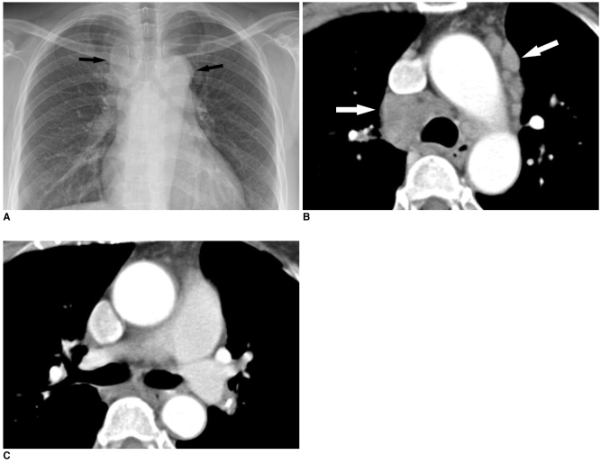
Sarcoidosis

Slide 53
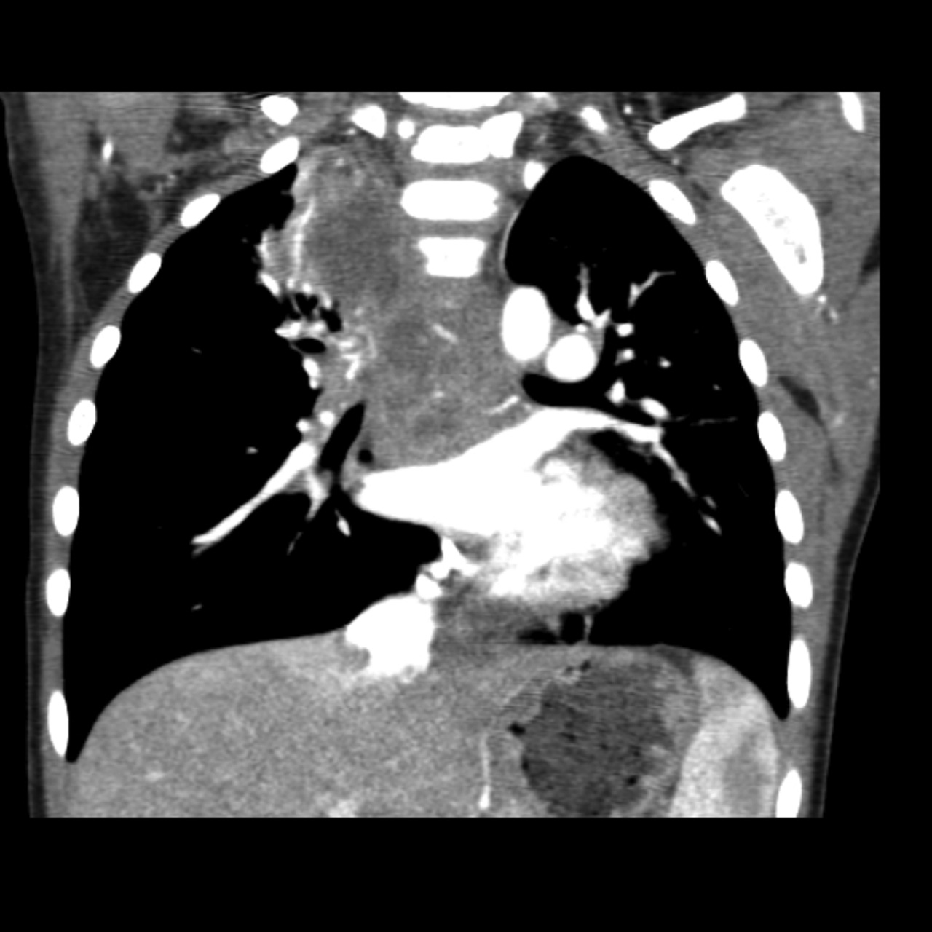
Tuberculosis: Mediastinal Abscess

Slide 54
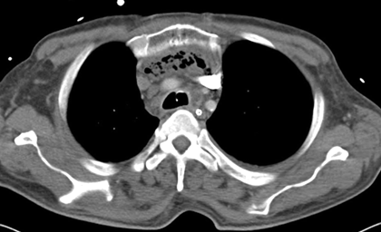
Mediastinitis
. . . in this case, emphasematous.

Slide 55
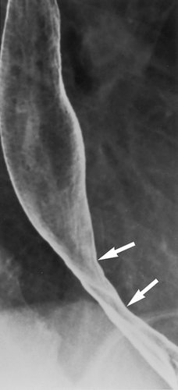
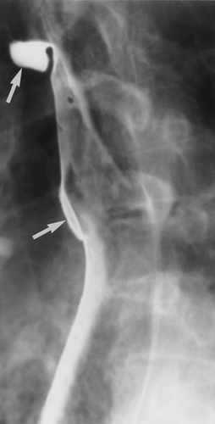
Scleroderma
Two patients;
same diagnosis.
Long area of peptic stricture. Wide-mouth sacculations (diverticula).

Slide 56
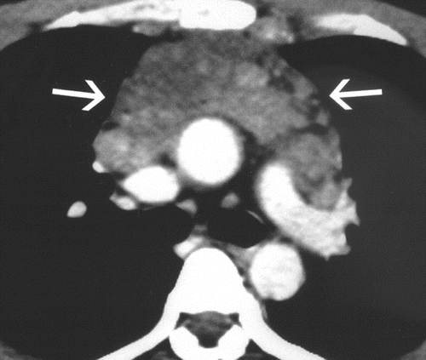
Castleman’s Disease = Angiofollicular or Benign Giant Lymph Node Hyperplasia

Slide 57
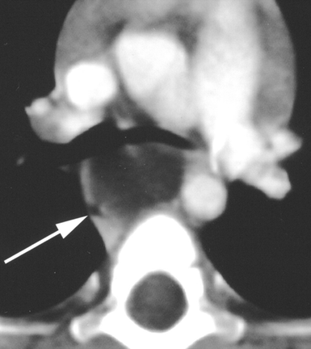
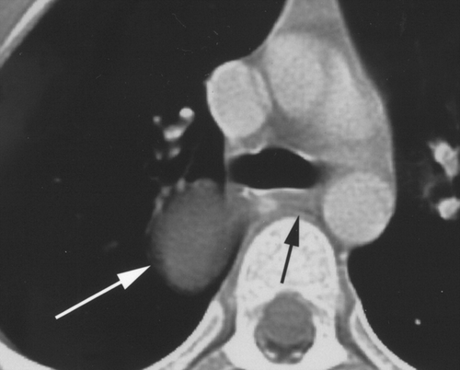
Lastly for today . . . .
9 month-old
8 year-old

Slide 58
Foregut Duplication Cyst(s)
8-year-old girl
9-month-old girl
Esophageal Bronchial
Notes:
The three most common kinds of foregut or bronchopulmonary foregut duplication cysts are esophageal, which is present in the image on your left, bronchial, present on your right, and neurenteric. They’re typically of water nearly water attenuation by CT.

Slide 59
A Diagnostic Approach to Mediastinal Abnormalities
Camilla R. Whitten, MRCS, FRCR, ,
Sameer Khan, MRCP, FRCR, ,
Graham J. Munneke, MRCP, FRCR, and ,
Sisa Grubnic, MRCP, FRCR
¹From the Department of Radiology, St George’s Hospital, Blackshaw Rd, Tooting, London SW17 0QT, England.
RadioGraphics 2007 27:3, 657-671
A number of mediastinal reflections are visible at conventional radiography that represent points of contact between the mediastinum and adjacent lung. The presence or distortion of these reflections is the key to the detection and interpretation of mediastinal abnormalities. Anterior mediastinal masses can be identified when the hilum overlay sign is present and the posterior mediastinal lines are preserved. Widening of the right paratracheal stripe and convexity relative to the aortopulmonary window reflection indicate a middle mediastinal abnormality. Disruption of the azygoesophageal recess can result from disease in either the middle or posterior mediastinum. Paravertebral masses disrupt the paraspinal lines, and the location of masses above the level of the clavicles can be inferred by their lateral margins, which are sharp in posterior masses but not in anterior masses. The divisions of the mediastinum are not absolute; however, referring to the local anatomy of the mediastinal reflections in an attempt to more accurately localize an abnormality may help narrow the differential diagnosis. Identification of the involved mediastinal compartment helps determine which imaging modality might be appropriate for further study.
© RSNA, 2007

